Slide 1
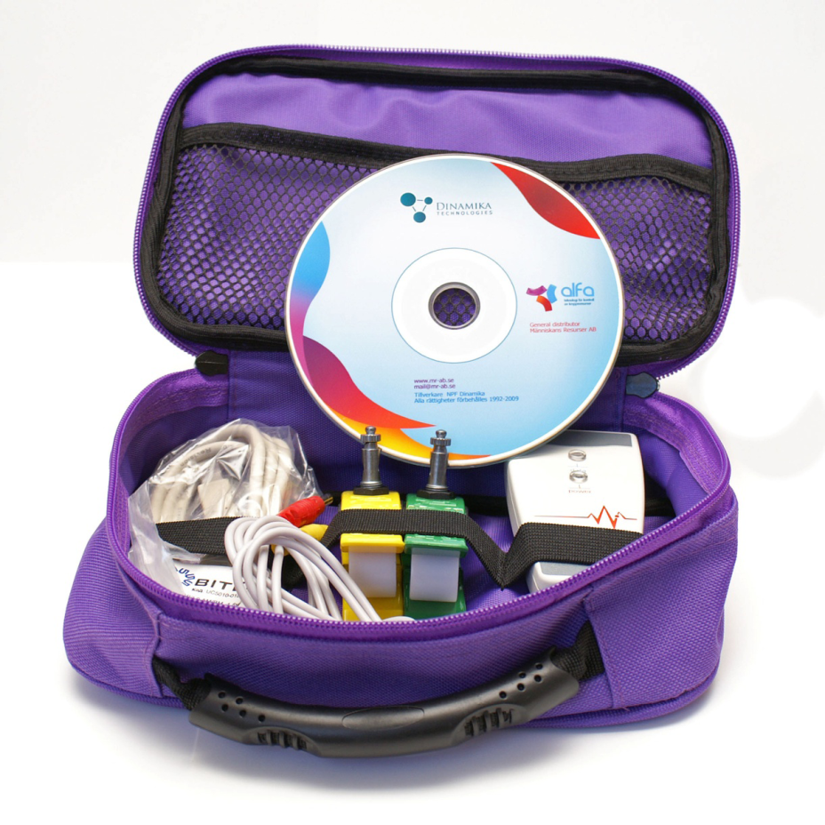
The “Alfa” device gives an analysis of the patient’s
health status quickly and objectively with the help
of the following procedures:
- ECG measurement;
evaluation of the vegetative system condition
by variance analysis
evaluation of the hormonal regulation and energy
resources of the body by neurodynamic analysis
evaluation of the psychoemotional state
by examination of brain biorythms
evaluation of the adaptation level of the body
and estimation of biological age by fractal analysis
- complete analysis of the results

Slide 2
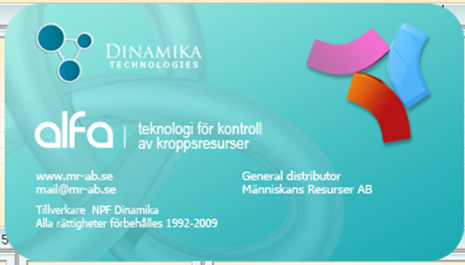
“Alfa” will provide people with a good opportunity to examine their health without unnecessary delay and to make prognosis of health development in such a way that saves both their time and energy.
“Alfa” allows it’s users to examine bodily functions in a short time by analyzing neurodynamic variables of heart rythms. Many years of research allowed to establish that all processes in a human organism are reflected in heart rythms changing activities.
Programs designed for “Alfa” equipment are based on a new method of analysis of biological rhythms of human organism. Since 1997 this type of equipment has been successfully used in the areas of clinical, practical and sports medicine in Russia, Europe, USA and South Korea.

Slide 3

Fundamental difference of Alfa" from other existing instruments, is designed creators of the original complex mechanism of application of methods of mathematical analysis of complex dynamic systems. The leading place among these methods is the fractal analysis used for the analysis of dynamic systems, with properties of self-similarity and nesting.

Slide 4
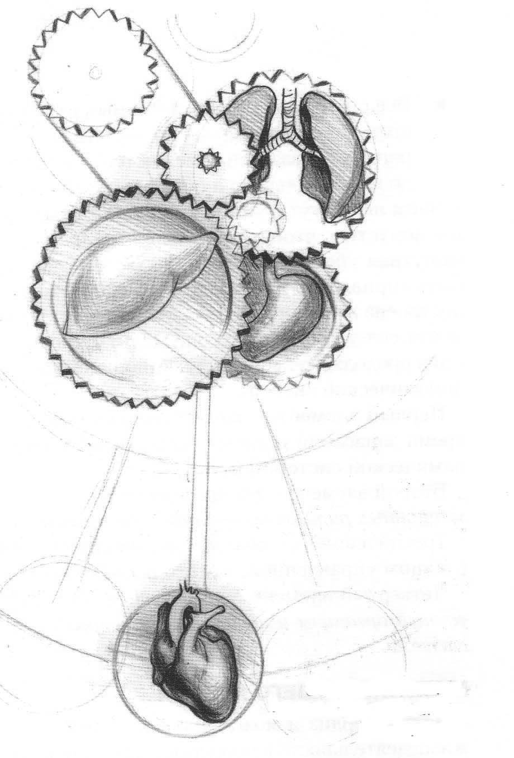
Pulse – the best health indicator
All the life processes in the human body are reflected by the pulse that is synchronized by the heart rhythms.
On one hand the heart rhythms reflect rhythms of the body as a whole – on the other hand its rhythms exert control of the vital processes of the body as they receive commands from the heart and the nervous system.
Even a small body strain causes a change of those rhythms. By monitoring the dynamics of the heart rhythms one can make an objective evaluation of an organism and its state and also forecast its changes.
This work of the “pendulum of the heart” is an individual factor for each person – precisely in the same fashion as one’s fingertips.

Slide 5
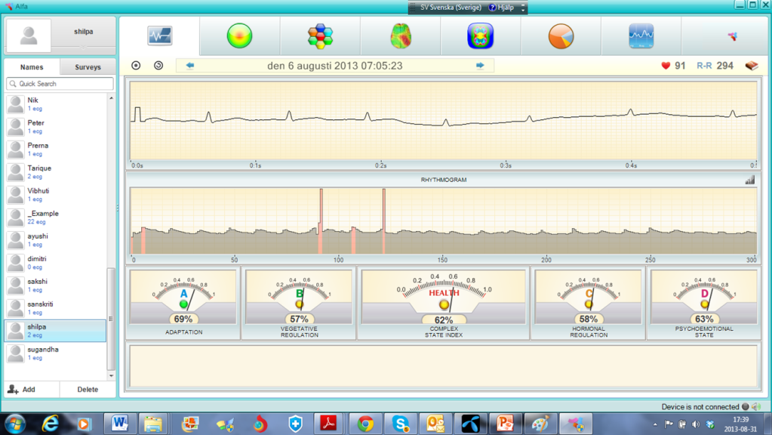
Alpha provides a clear presentation of the body's health resources and how it reacts to / how effective:
physical exercise
drug
therapeutic treatments
Food, supplements
Coffee, alcohol, cigarettes, etc.
Does not work on: Pacemaker, arrhythmia
10 studies carried out between 1996-2005. A total of 2,687 individuals were included in the studies. The results are very positive.

Slide 6
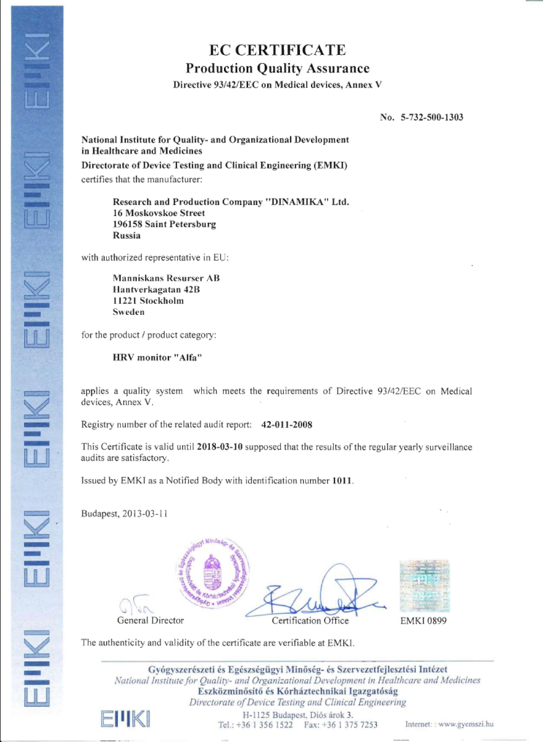
The production of "ALFA is quality assured to ISO 9001:2008 and has approval by EU certificate CE 1011.

Slide 7
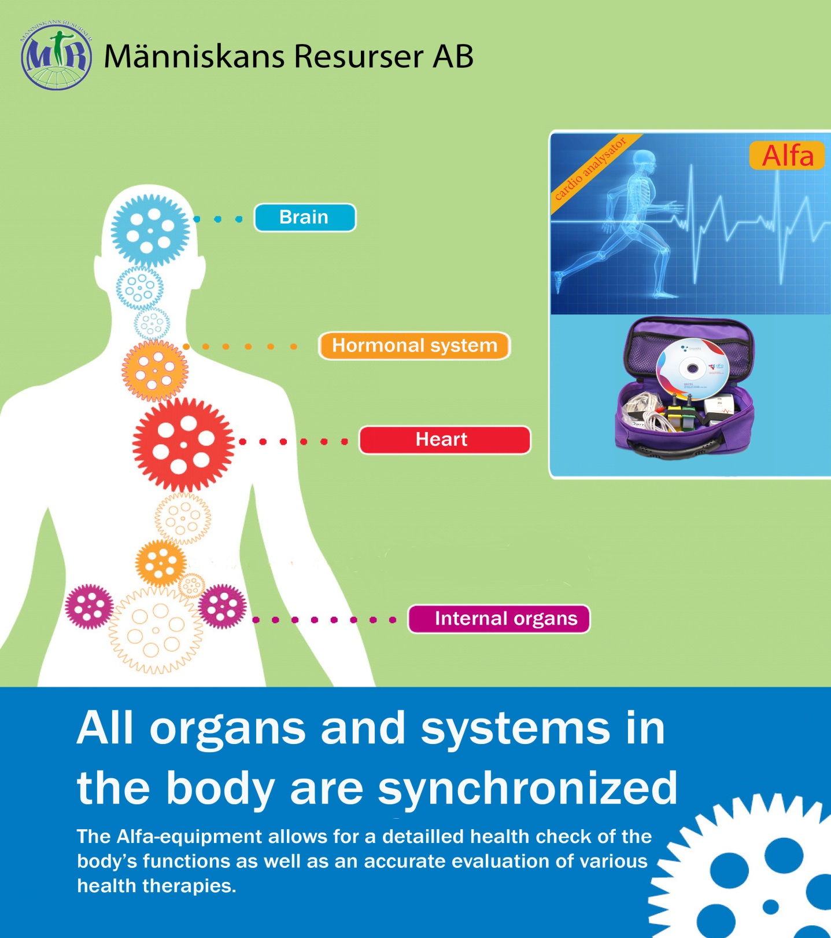

Slide 8
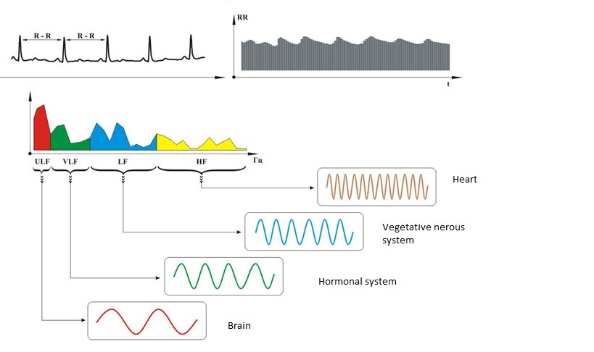
Rhythms of all body systems in sync
All systems have their frequencies

Slide 9
How to measure Alpha
All organs and cells are controlled by the body's regulatory mechanisms. To the body's regulatory mechanisms belonging to the brain, nervous system and hormonal system. Their bioelectrical signals are different but at the same time they are synchronized. At the change of bioelectric signals of the brain changes synchronous also bioelectric signals from the nervous system and the hormonal system
The all-regulating system coupled to the sinus node, which in turn controls the heart or kadiorytm. When changes in the internal or external environment is changing regulatory systems to adapt your body to these changes by altering the heart's rhythm. Alfa's super sensitive microchip measures the pulse containing different frequencies from the brain, nervous system, hormonal system and sends it to Alfas program
The program separates the bioelectrical signals from each system by nejrodynamisk fractal analysis, and in this way we can evaluate each system. It is known that the cells' production of energy coupled to the combination of bioelectrical signals from the nervous system and endocrine system. When the program measure these signals, we can mathematically calculate the cells produce energy.

Slide 10
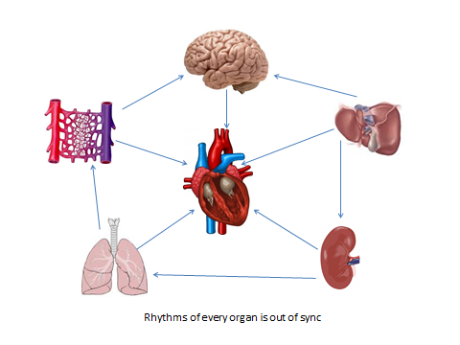

Slide 11
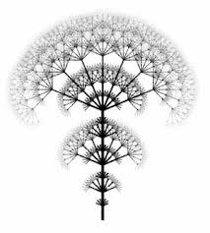


Every physiological process has its own unique rhythm, these rhythms are similar, and are reflected in the rhythms of the heart. But this means that examined only one rhythm method of fractal analysis can reveal the structure and dynamics of other rhythms and us to conclude about the state of the respective regulatory systems

Slide 12
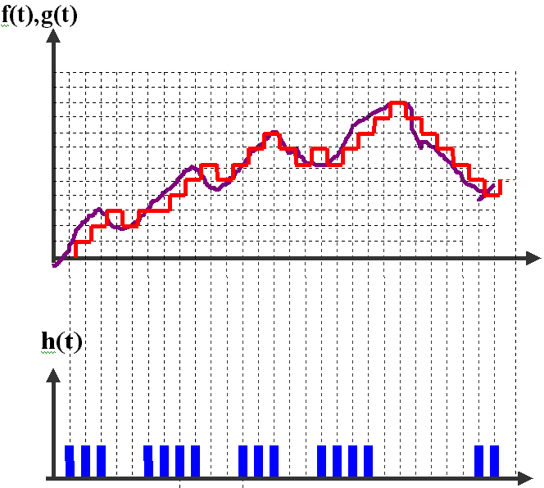
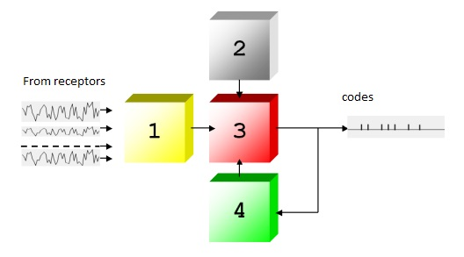
In all complexes "Dynamics" present unique algorithmic block digital analysis of heart rate. How does it work?
Specialized computer software translates Rhythmogram in the binary system. Further, analyzing the binary code, the program identifies the code sequences corresponding to different time slots.

Slide 13
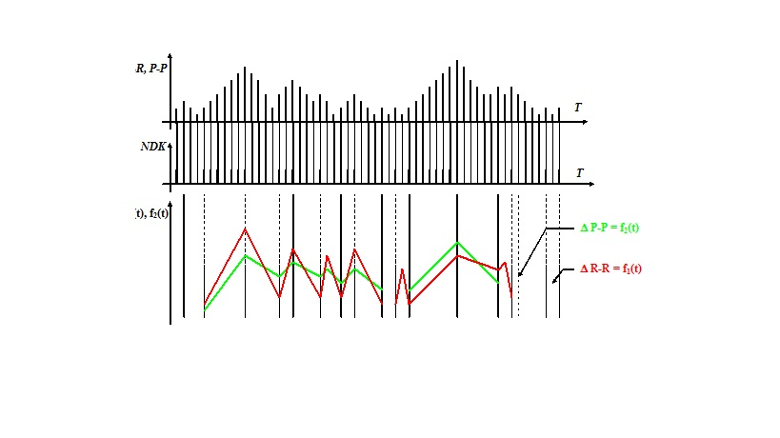
Each code carries a piece of information about the quality of the functioning of the regulatory system at their level

Slide 14
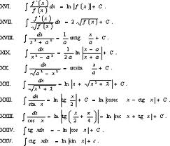
Based on fractal mathematical analysis program can calculate the rhythms and the function of each system

Slide 15
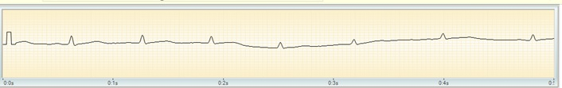
ECG curve
Examination time in minutes and seconds is stored along the horizontal axis, and the ECG amplitude along the vertical

Slide 16
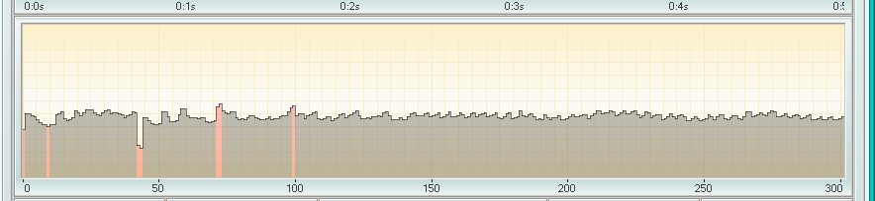
Rytmogram
Rytmogram is a curve formed when storing the intervals RR number along the horizontal axis and the intervals of seconds along the vertical axis. RR interval is the time interval between two successive heart beats.
Artifacts, ie extrasystoles or interference, highlighted by pink on rytmogrammet.

Slide 17
The autonomic nervous system consists of nerves that control the functions of various organs which are not directly volitional, such as heart, liver, stomach, salivary glands, etc.
The autonomic nervous system consists of two parts, the sympathetic and parasympathetic systems, which work against each other, antagonistic. Put simply, one can say that the sympathetic nervous system controls energy-consuming documents (fight / flight), while the parasympathetic control over energy saving documents (rest and digestion).

Slide 18
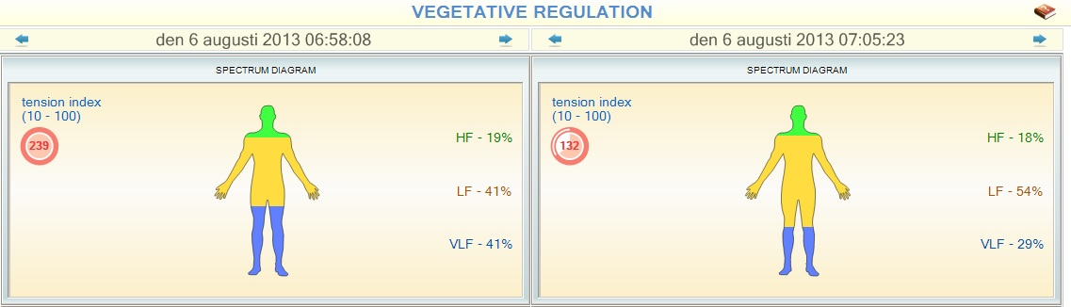
HF - High frequencee
Green – parasympathetic
Low frequencies
Gul – sympathetic
VLF - very low frequency
blue-hormonal system
Tension index
Characterize the degree of myocardial stress and shows how strained
body's various regulatory systems. Normal Value: 10-100.

Slide 19
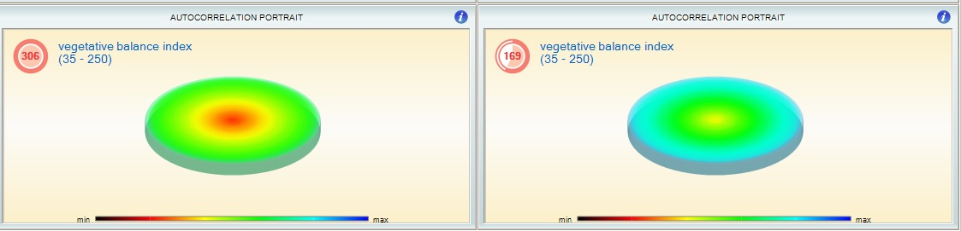
The Vegetative Balance Index provides a correlation between the activity of the sympathetic and parasympathetic divisions of the vegetative nervous system as well as the degree of involvement of central nervous system in this process. The more red color seen in the centrer of the circle, the higher the degree of involvement of the central nervous system in the processes of regulation processes.

Slide 20
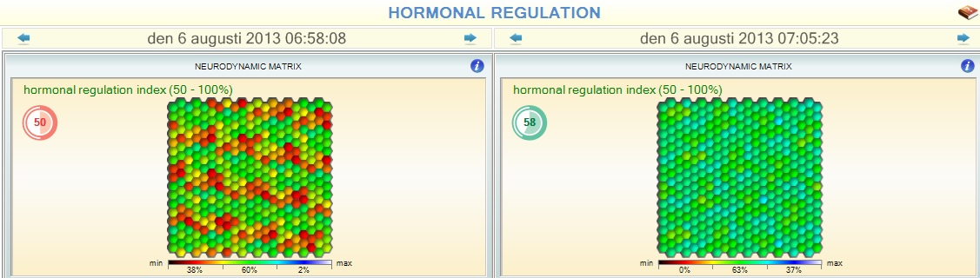
HORMONAL REGULATION. The endocrine system creates a certain hormonal profile, which helps the body to withstand external and internal influences and adapts to such influence. It is the functioning of the hormonal system which determines how optimally the body uses its energetic and physiological resources. The indicator of hormonal regulation of endocrine system is the exact reflection of the quality with which the endocrine system resolves its tasks.

Slide 21
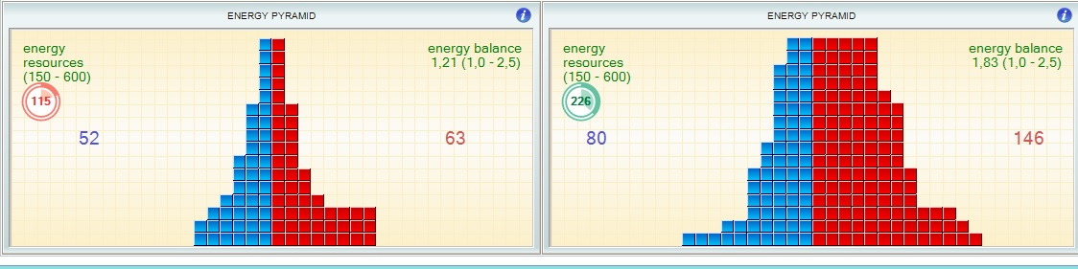
Energy Pyramid
The “Energy Pyramid” is a dynamic representation of the energy balance in the management systems of the different functions in the body. The blue side corresponds to the period of energy storage by different organs and systems in the body. On the other hand, red side corresponds to the period of energy.
The sum of the values of the blue and red indicators shows a general quantity of energy resources utilizations in the body. The higher the value of this indicator , the more adaptive capacity the body is capable of, and the better the patient will resist stress and cope with different stresses.

Slide 22
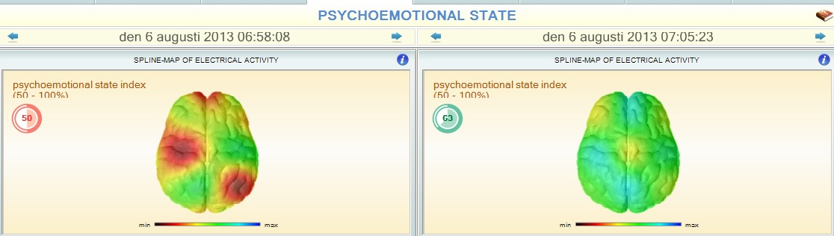
The hypothalamus is one of the main regulating mechanisms of the body. It has a direct influence on the functions of the brain. In turn functions of the brain manage other regulation processes in organism the body. Colors in the image correspond to different levels of electric activity, and their distribution provides a gauge of the current psychoemotional status of the patient. This indicator of psychoemotional status demonstrates how strongly stressful situations affect the human body.

Slide 23
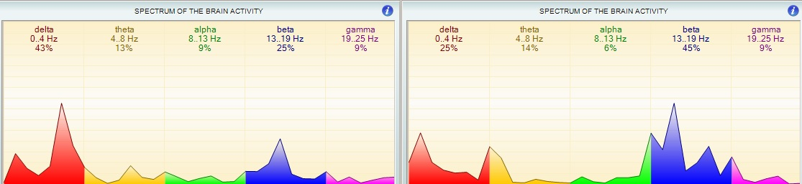
Brain activity waves
Our brain radiates waves of different frequency and there is a direct correlation between the activity of a person, his/her level of concentration or attention and brain wave frequency. In a normal awake state all frequencies of brain waves (alpha, beta, delta, gamma, and theta) are active. Depending on what person is doing and his/her psychoemotional status, certain wave may be more active than the other ones.
Delta (0.1-4 Hz). Highest delta wave activity occurs during sleep.
Theta (4-8 Hz). Highest theta wave activity occurs just before sleep. Presence of a certain amount of theta waves in combination with Alpha ( 8-13 Hz) waves may suggest creative abilities. A high level of theta waves suggests a good connection to the with subconscious.
Beta (13-19 Hz). Highest beta wave activity occurs in a state of consciousness and activity.
Gamma (19-25 Hz) - Gamma wave activity suggests an altered state of consciousness

Slide 24
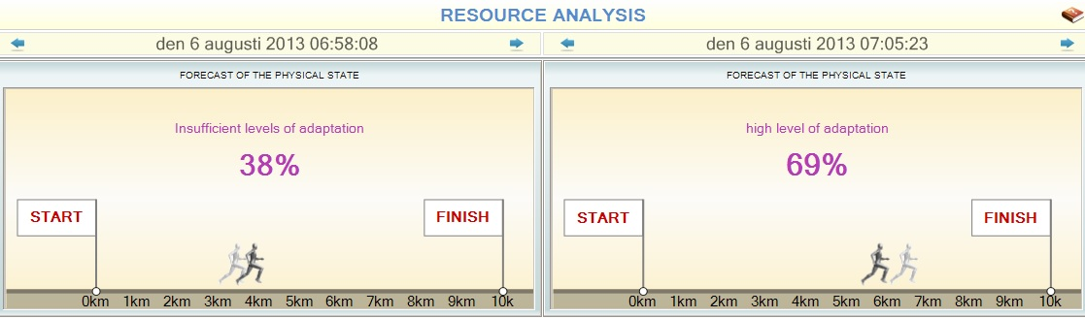
Analysis of resources
The indicator entitled “Level of Organism Adaptation” shows the quality of functional status of the body.
The higher the level of adaptation, the more quickly, painlessly and effectively the body will respond to different types of load. The percentage display shows the resource level of the cardiovascular system and does not include the auxiliary regulatory systems. Shadow shows average adaptation that humans used to have, second man show adaptation today

Slide 25
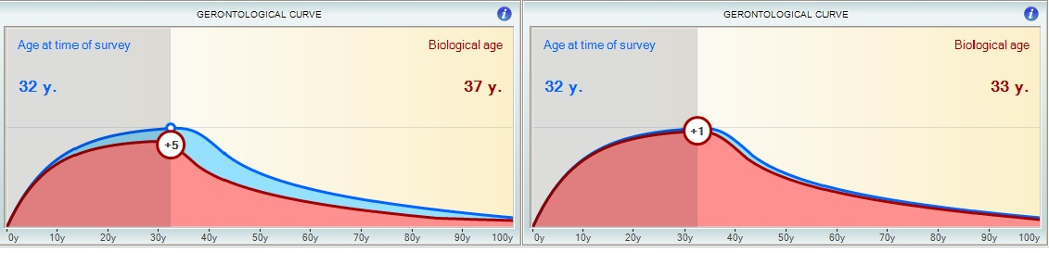
Gerontological Curve
Using a “gerontological curve” allows the determination the biological or genuine age of the patient.
The reference “gerontological curve” was developed using statistical analysis of the biorhythms of more than 10 000 patients of different age groups and serves as a graphical representation of the pace of accumulation and expenditure of living resources in an average human over a 100 year life cycle. Patients may be younger or older than their chronological age and the biological age is often inconsistent to the person’s actual age-Genuine, biological age reflects the true vitality of a person,

Slide 26
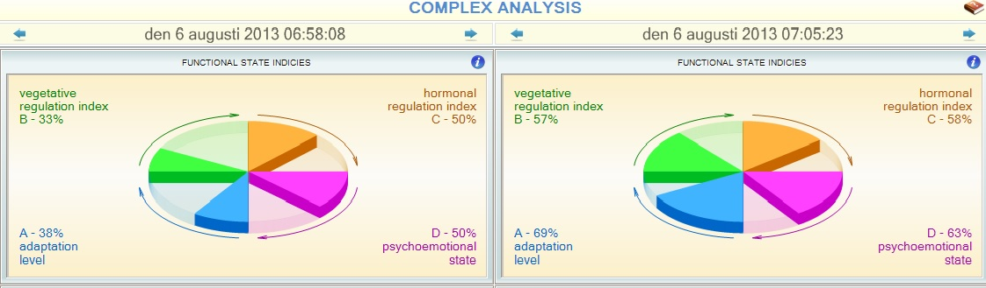
Complex Analysis
The complex analysis of health reflects the quality of physiological processes in a person and the level of his/her balance. It serves as a conditional mathematical representation of the “health status of a person”.

Slide 27
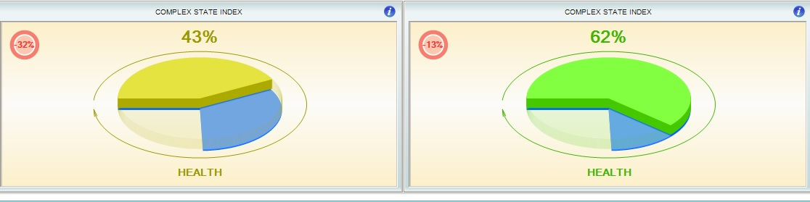
Health status for today

Slide 28
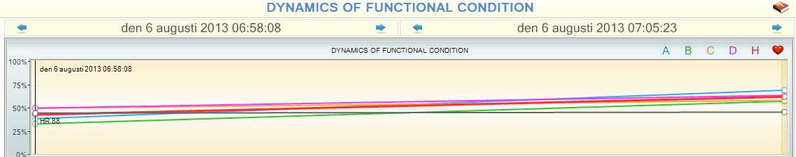
Difference of health parameters at different times

Slide 29
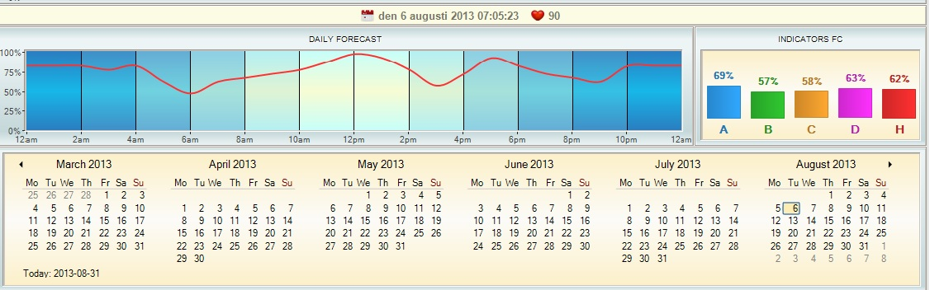
Daily Prognosis of health

